Slide 1
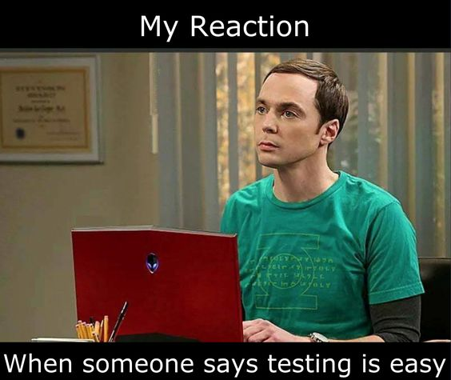
Introduction to
Unit Tests

Slide 2
Agenda
Motivation
Case study: NUnit
Testing
Basic parts of a unit tests
What does a unit test look like?

Slide 3
Motivation: Manually test
class Program
{
static void Main(string[] args)
{
// Declare the unit-under-test
var uut = new Calculator();
// Test Add()
Console.WriteLine("Add({0}, {1}) = {2}", 3.5, 2.5, uut.Add(3.5, 2.5));
Console.WriteLine("Add({0}, {1}) = {2}", -3.5, 2.5, uut.Add(-3.5, 2.5));
Console.WriteLine("Add({0}, {1}) = {2}", -3.5, -2.5, uut.Add(-3.5, -2.5));
// Test Subtract()
Console.WriteLine("Subtract({0}, {1}) = {2}", 3.5, 2.5, uut.Subtract(3.5, 2.5));
Console.WriteLine("Subtract({0}, {1}) = {2}", -3.5, 2.5, uut.Subtract(-3.5, 2.5));
Console.WriteLine("Subtract({0}, {1}) = {2}", -3.5, -2.5, uut.Subtract(-3.5, -2.5));
// Test Multiply()
Console.WriteLine("Multiply({0}, {1}) = {2}", 3.5, 2.5, uut.Multiply(3.5, 2.5));
Console.WriteLine("Multiply({0}, {1}) = {2}", -3.5, 2.5, uut.Multiply(-3.5, 2.5));
Console.WriteLine("Multiply({0}, {1}) = {2}", -3.5, -2.5, uut.Multiply(-3.5, -2.5));
// Test Power()
Console.WriteLine("Power({0}, {1}) = {2}", 2.0, 3.0, uut.Power(2.0, 3.0));
Console.WriteLine("Power({0}, {1}) = {2}", -2.0, 3.0, uut.Power(-2.0, 3.0));
Console.WriteLine("Power({0}, {1}) = {2}", -2.0, -3.0, uut.Power(-2.0, -3.0));
}
}
public class Calculator {
public double Add(double a, double b) {
return a + b;
}
public double Subtract(double a, double b) {
return a - b;
}
public double Multiply(double a, double b) {
return a * b;
}
public double Power(double a, double b) {
return Math.Pow(a,b);
}
}

Slide 4
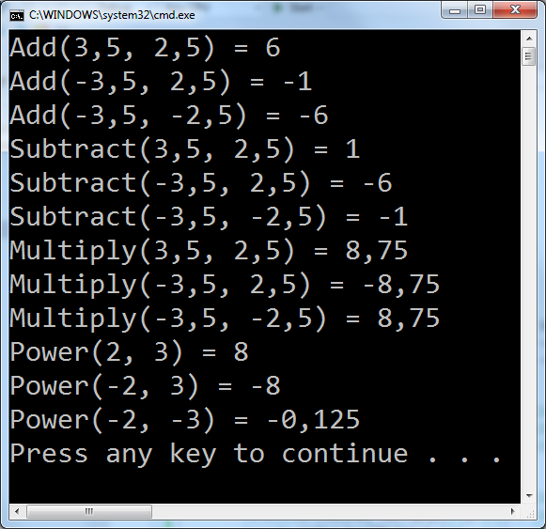
Validate result?

Slide 5
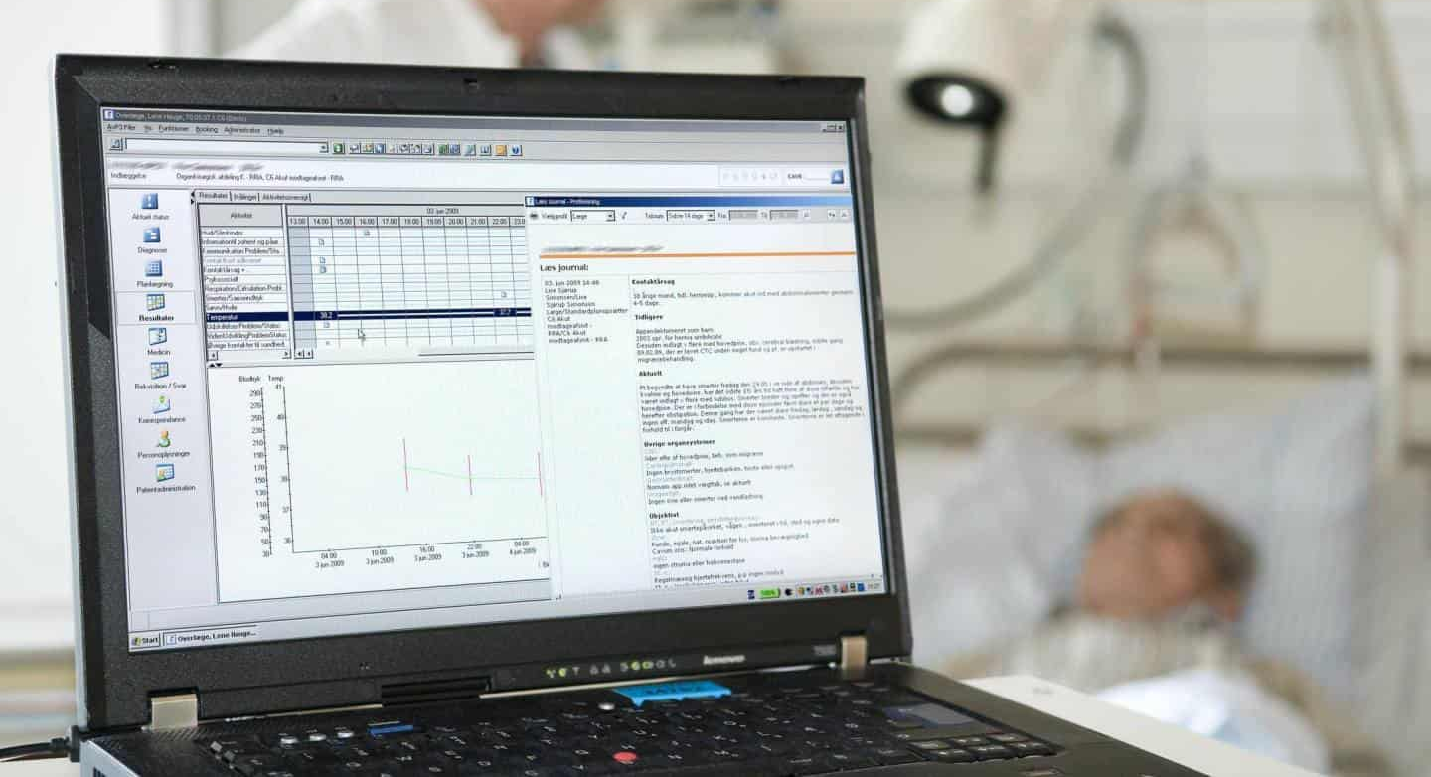

Slide 6
Test also gives...
specifications built into the program
confidence in code
early error finding
decoupled system
better design

Slide 7
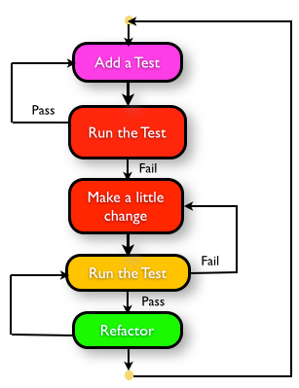
How to plan and execute test
Define a scenario
Write the [TestCase]
Run the test
Implement the code
Repeat

Slide 8
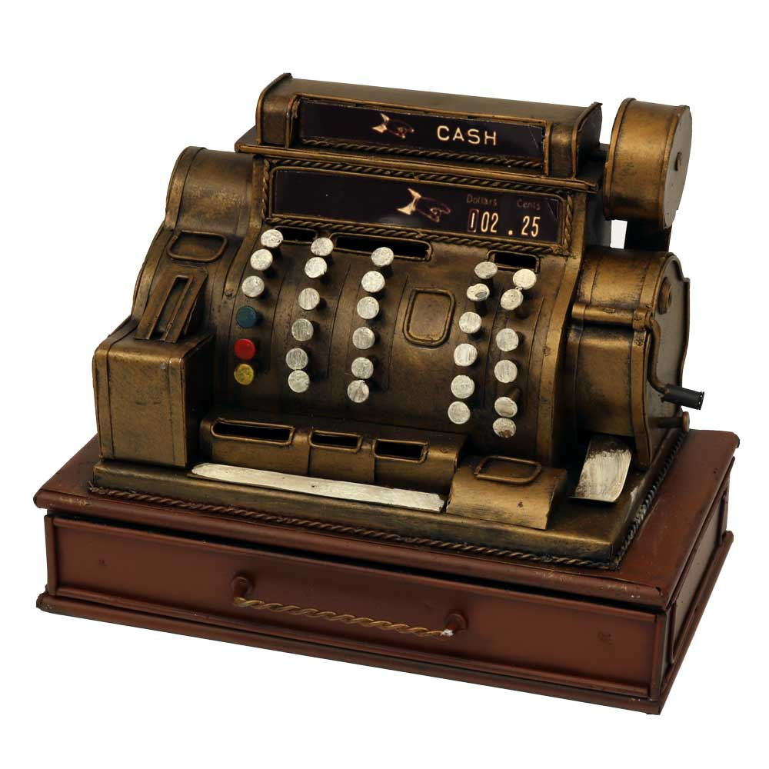
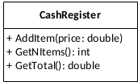
Demo: A cash register
We will implement and test a class CashRegister
Your turn: What test cases do we need for each of the class’ methods?
What is the scenario?
What is the test input?
What is the expected result?

Slide 9
Your turn
For around 30 minutes do
Do ‘Exercise 1: Plan your tests’
Continue to ‘Exercise 2: Prepare workspace’ when you are done with 1.

Slide 10
NUnit

Slide 11

Test framework
Gives:
Support for automation
Easy setup and removal
Good assertion constructs
Detailed test reports
Nice IDE integration
Testing styles

Slide 12
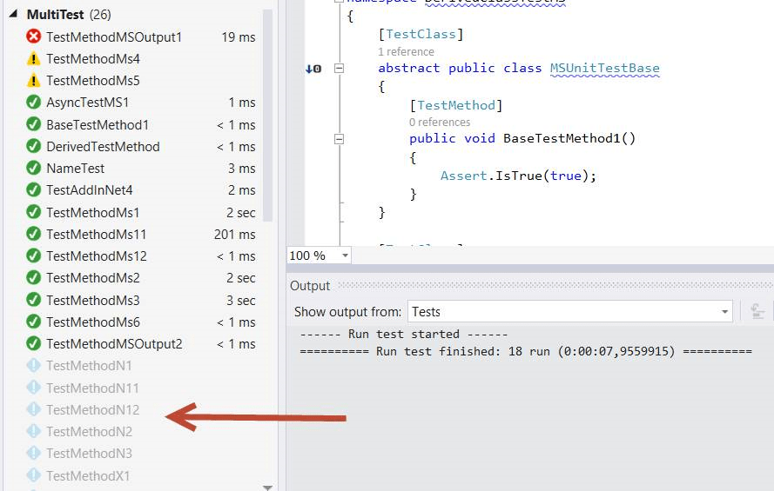
Automation / test report

Slide 13
Nunit example
[TestFixture]
public class UnitTest1 {
Calculator uut;
[Setup]
public void Setup() {
uut = new Calculator();
}
[Test]
public void Test_AddMethod() {
double res = uut.Add(3.5, 2.5);
Assert.AreEqual(res, 6);
}
…
}

Slide 14
NUnit assertion - constraints
Constraint based assert model
Assert.That(uut.Count, Is.EqualTo(10));
Actual state
Constraint with expected state
Other constraints examples - many more exists
Assert.That(uut.Count, Is.GreaterThan(3));
Assert.That(myString, Is.EqualTo("Hello"));
Assert.That(array, Has.Exactly(3).LessThan(100));
More constraints https://nunit.org/docs/2.5/constraintModel.html

Slide 15
Test framework
Assertions Different ways to compare expected and actual test results in a readable way
Test case Each test case - tests one specific, isolated aspect of the unit-under-test
Test fixture Collects test cases, helps with setup, teardown, etc.
Test runner Runs the tests and reports the result
Test reports Result of the tests run

Slide 16


A unit tests
Unit-under-test
(UUT)
Expected result?
Input
Scenario
Output
Icons: FrICONiX.com

Slide 17
Demo: A cash register
Let us implement the CashRegister

Slide 18
Your turn
Continue with exercises

Slide 19
Testing
and Pitfalls

Slide 20
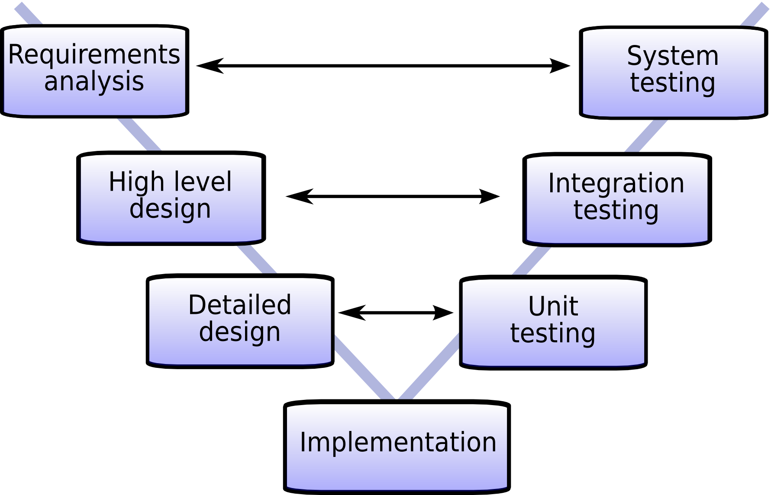

Slide 21
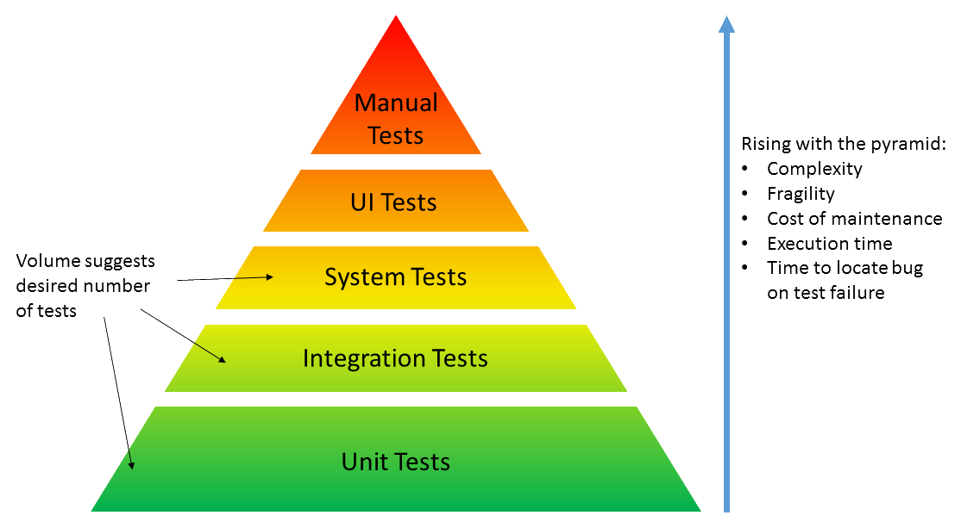
Why test? Why unit test?
Notes:
Speed
Security
Design

Slide 22
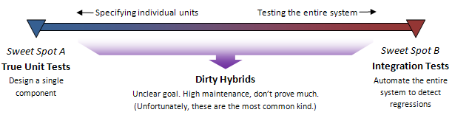
Pitfalls
True unit test contains information about design and behaviour of UUT (Unit-under-test)
Do not make any assumption about other parts
Integration test do not tell anything about how code base is broken down into units
Make assumptions about the whole system behaviour
In between
Small changes breaks unrelated test
Tests breaks - but system works as “expected”

Slide 24
Reference
TDD: agilefaqs.com/services/training/test-driven-development
Dancing man: https://giphy.com

